Slide 1
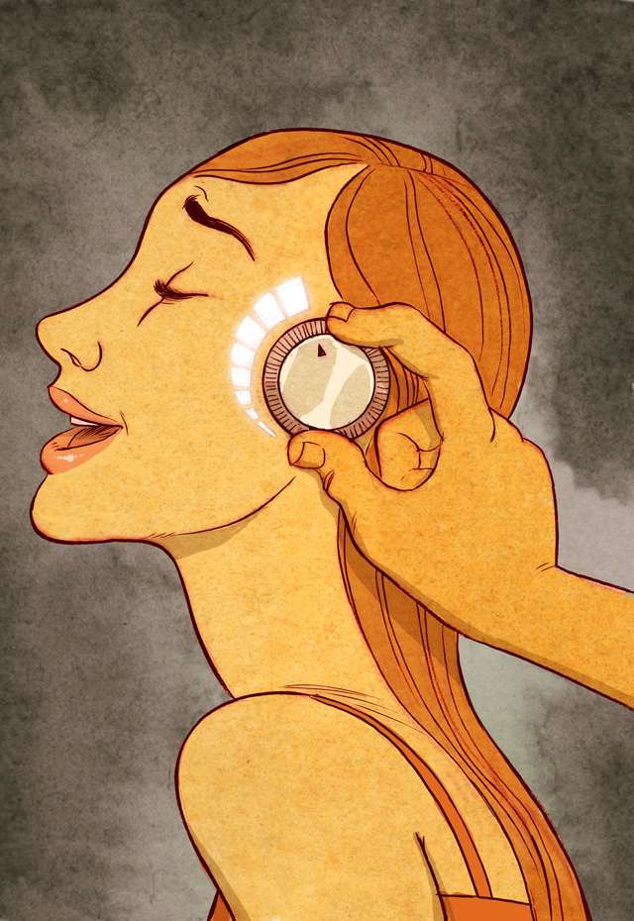
Goodness & Pleasure
PH1102E, Week 3

Slide 2
Today’s Plan
I. Moral philosophy overview
A. Norms and value
B. Absolute vs. instrumental value
II. Hedonism
III. Arguments against hedonism
A. Haydn and the Oyster
B. Lives barely worth living
C. Experience machines
D. Argument from beauty

Slide 3
Moral philosophy overview
Moral philosophy is the study of norms and values. It centers on two main questions:
What is good for its own sake?
What may we do in our pursuit of what is good for its own sake?

Slide 4
Norms and Value
Moral philosophy is the study of value and norms. It centers on two main questions:
What is good for its own sake? (A question of value: good vs. bad.)
How should I act? (A question of norms: right vs. wrong.)
Notes:
Two kinds of answer to 2: consequentialist (=you should act in ways that maximize the total amount of that which is good for its own sake), and non-consequentialist (e.g., you should act only on benevolent intentions).

Slide 5
Norms and Value
Moral philosophy is the study of value and norms. It centers on two main questions:
What is good for its own sake? (A question of value: good vs. bad.)
How should I act? (A question of norms: right vs. wrong.)

Slide 7
Value: absolute vs. instrumental

Slide 8
Value: absolute vs. instrumental
Something is absolutely good if it is good for its own sake, and absolutely bad if it is bad in and of itself.
Something is instrumentally good if it has a net balance of absolutely good effects, and instrumentally bad if it has a net balance of absolutely bad effects.

Slide 9
Value: absolute vs. instrumental
Something is absolutely good if it is good for its own sake, and absolutely bad if it is bad in and of itself.
Something is instrumentally good if it has a net balance of absolutely good effects, and instrumentally bad if it has a net balance of absolutely bad effects.

Slide 10
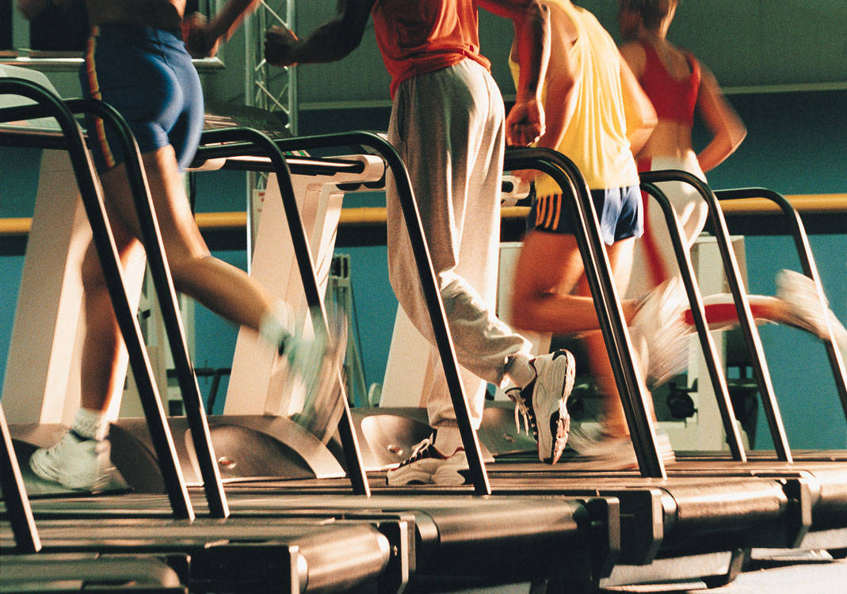
Instrumentally, but not absolutely, good
Notes:
Excercise: instrumentally, but probably not absolutely, good

Slide 11
Instrumentally, but not absolutely, good
Notes:
Excercise: instrumentally, but probably not absolutely, good

Slide 13
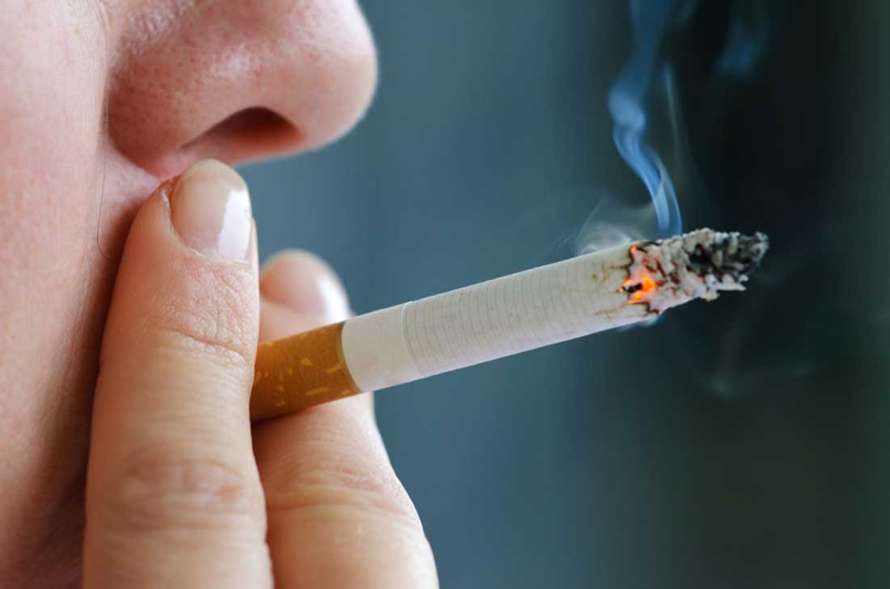
Instrumentally, but not absolutely, bad
Notes:
Instrumentally, but not absolutely, bad.

Slide 14
Instrumentally, but not absolutely, bad
Notes:
Instrumentally, but not absolutely, bad.

Slide 15
Hedonism

Slide 16
Hedonism is a theory of absolute value.
It says that the only thing that is absolutely good is pleasure, and the only thing that is absolutely bad is pain.
What is good for its own sake = pleasure.
What is bad for its own sake = pain.

Slide 17
There are two kinds of hedonism: egoistic, and non-egoistic.

Slide 18

Egoistic Hedonism
An egoistic hedonist says that the only thing that is good for its own sake is his own pleasure, and the only absolutely bad thing his own pain.
Other people’s pain is funny. Mine hurts.
-- B. Simpson

Slide 19

Non-egoistic Hedonism
A non-egoistic hedonist says that all pleasure is good for its own sake, and all pain is absolutely bad: it doesn’t matter whether the pleasure or pain is mine, yours, or someone else’s.

Slide 20
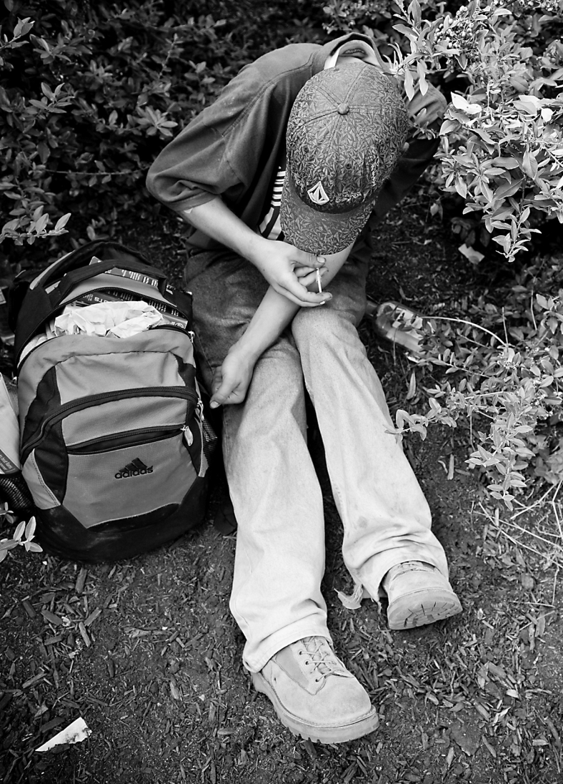
Hedonism says that every pleasure is absolutely good.
But that doesn’t mean that every pleasure is worth pursuing.
Sometimes you have to forgo a present pleasure in order to avoid future pain (or lost opportunities for even more pleasure).

Slide 21
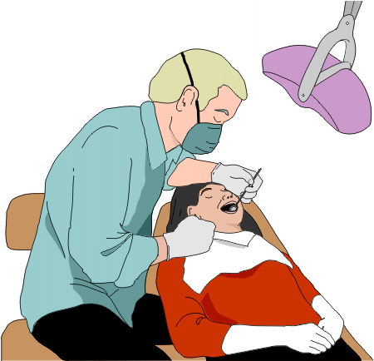
Hedonism says that every pain is absolutely bad.
But that doesn’t mean that every pain should be avoided.
Sometimes you have to accept pain to get even more pleasure (or, to avoid even greater pain) in the future.

Slide 22
Hedonists think that pleasure is the only thing that is good for its own sake, and that pain is the only thing is bad in and of itself.
What do you think?

Slide 23
Are you a hedonist?

Slide 24
Arguments against hedonism

Slide 25
Today we consider four arguments against hedonism:
1. The “oyster” argument
2. The “barely worth living” argument
3. The “experience machine” argument
4. The argument from beauty

Slide 26
Haydn vs. the Oyster

Slide 27
Haydn vs. the Oyster

Slide 28
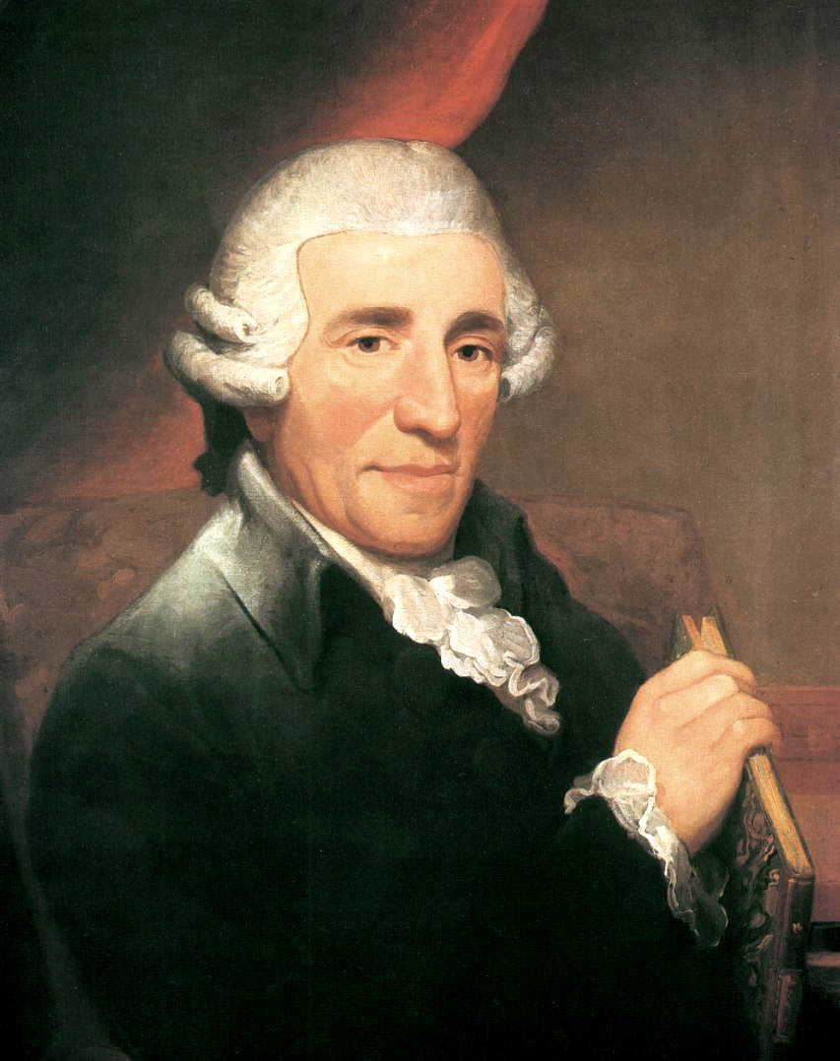
Franz Josef Haydn (1732-1809)

Slide 29
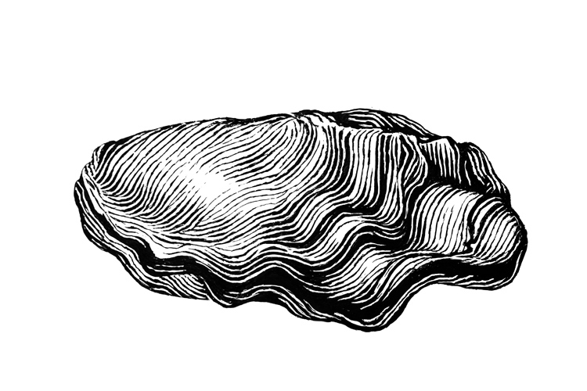
Franz Josef Haydn (1732-1809)
∞
Oyster (1732- )

Slide 30
Which life do you choose?
Franz Josef Haydn (1732-1809)
∞
Oyster (1732- )

Slide 31
Notes:
Explain why this is supposed to be an argument against hedonism.

Slide 32
Franz Josef Haydn (1732-1809)
∞
Oyster (1732- )

Slide 33
How can a hedonist respond to this?

Slide 34
Option #1: Incommensurable pleasures
!

Slide 35
Option #1: Incommensurable pleasures
Haydn’s pleasures are incommensurable with the oyster’s: they are so unlike that it is impossible to compare them in terms of a common measure.
But what about the drunk bather?
And anyway, if the pleasures are incommensur-able, doesn’t the hedonist have to say it’s a coin toss which life you should choose?

Slide 36
Option #1: Incommensurable pleasures
Haydn’s pleasures are incommensurable with the oyster’s: they are so unlike that it is impossible to compare them in terms of a common measure.
But what about the drunk bather?
And anyway, if the pleasures are incommensur-able, doesn’t the hedonist have to say it’s a coin toss which life you should choose?

Slide 37
Option #1: Incommensurable pleasures
Haydn’s pleasures are incommensurable with the oyster’s: they are so unlike that it is impossible to compare them in terms of a common measure.
But what about the drunk bather?
And anyway, if the pleasures are incommensur-able, doesn’t the hedonist have to say it’s a coin toss which life you should choose?

Slide 39
Option #2: Average vs. total pleasure

Slide 40
Option #2: Average vs. total pleasure
The important thing is not the total quantity of pleasure, but the average quantity of pleasure over the course of one’s entire life.
But then you should choose the life of a short-lived heroin addict over the life of Haydn or the oyster.

Slide 41
Option #2: Average vs. total pleasure
The important thing is not the total quantity of pleasure, but the average quantity of pleasure over the course of one’s entire life.
But then you should choose the life of a short-lived heroin addict over the life of Haydn or the oyster, according to hedonism.

Slide 42
Option #3: Pro-oyster

Slide 43
Option #3: Pro-oyster
The oyster’s life is the better of the two!
The only reason you hesitate to choose the oyster’s life over Haydn’s is that you think that you would get bored being an oyster.
But boredom is a kind of pain, and the Angel has guaranteed that you will have no pain, and consequently that you will not get bored.

Slide 44
Option #3: Pro-oyster
The oyster’s life is the better of the two!
The only reason you hesitate to choose the oyster’s life over Haydn’s is that you think that you would get bored being an oyster.
But boredom is a kind of pain, and the Angel has guaranteed if you choose the oyster’s life you will have no pain, and therefore will never get bored.
Notes:
As Haydn, you will never remember having ever been anything but Haydn, and as an oyster, you will never remember having ever been anything but the oyster.

Slide 45
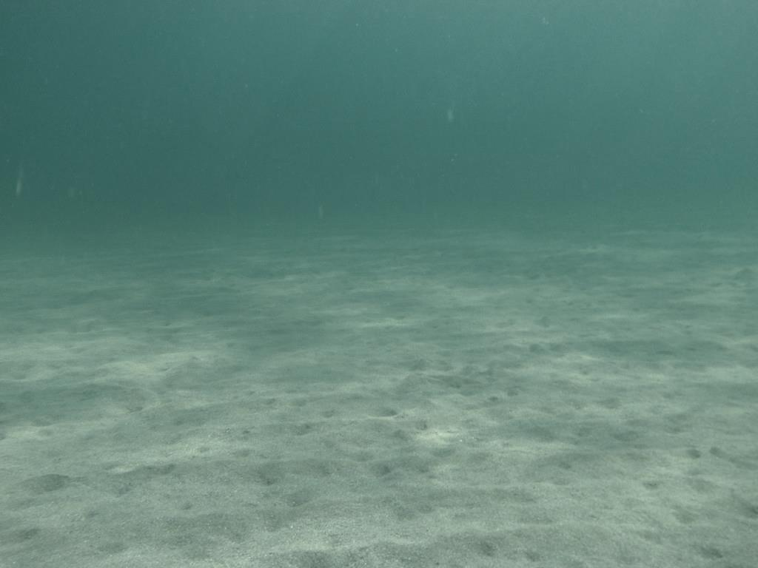
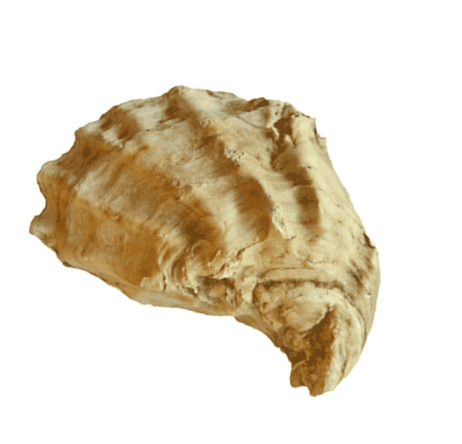
Notes:
Explain why this is supposed to be an argument against hedonism.

Slide 46
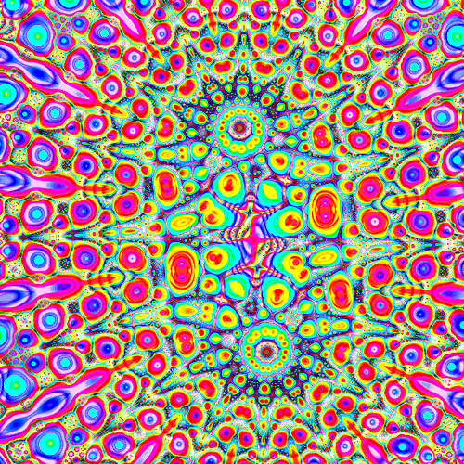
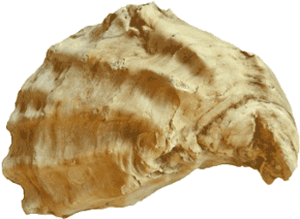
Notes:
Explain why this is supposed to be an argument against hedonism.

Slide 48
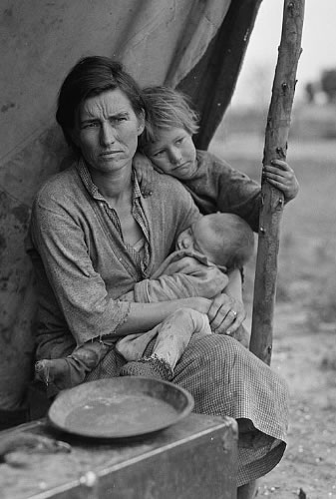
Lives barely worth living

Slide 49
Barely worth living
Call a life “barely worth living” if it contains just slightly more pleasure than pain (slightly more enjoyment than suffering).
The total amount of pleasure enjoyed by someone whose life is barely worth living exceeds the total amount of pain that he or she suffers, but not by much.

Slide 50
Barely worth living
Call a life “barely worth living” if it contains just slightly more pleasure than pain (slightly more enjoyment than suffering).
The total amount of pleasure enjoyed by someone whose life is barely worth living exceeds the total amount of pain that he or she suffers, but not by much.
Notes:
Imagine two worlds…

Slide 51
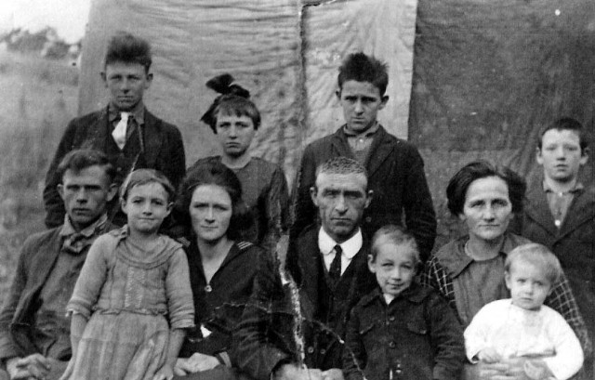
Life in Barely-Worth-It World

Slide 52

Life in Awesome World

Slide 53
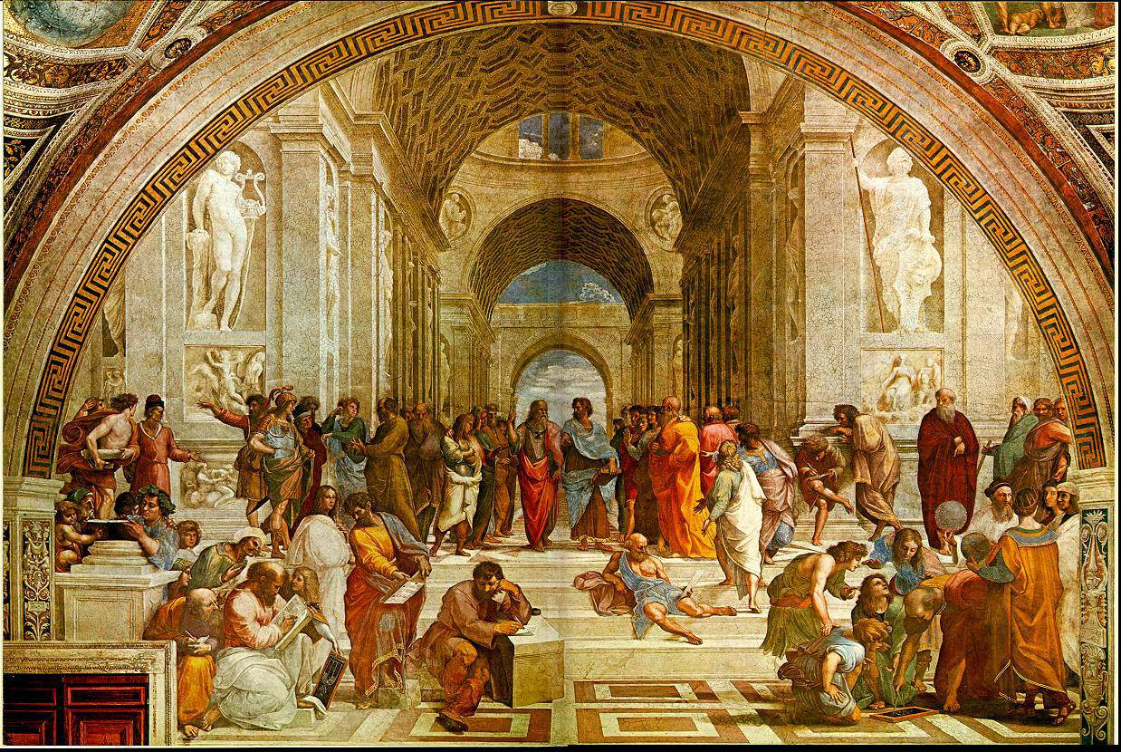
Life in Awesome World

Slide 54
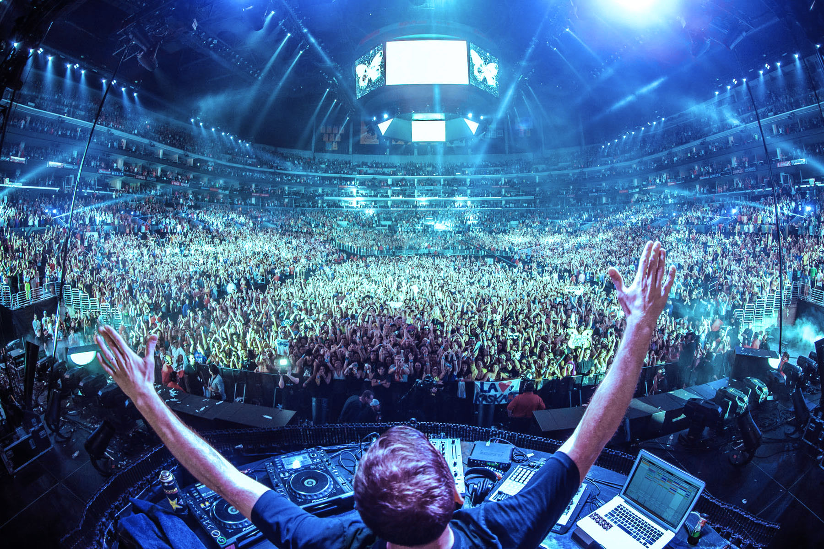
Life in Awesome World

Slide 55
Which world is better: Barely-Worth-It World or Awesome World?
A hedonist must say that Dystopia is a better world than Utopia, since Dystopia contains a greater total amount of pleasure.

Slide 56
Which world is better: Barely-Worth-It World or Awesome World?
A hedonist must say that Barely-Worth-It World is better, since Barely-Worth-It World contains a greater total amount of pleasure than Awesome World.

Slide 57
But so what?

Slide 58
But so what?
Wouldn’t a world of one million 99% pleased people be better than a world of one thousand 100% pleased people?
By the same logic, Barely-Worth-It World is better than Awesome World.

Slide 59
But so what?
Wouldn’t a world of one million 99% pleased people be better than a world of one thousand 100% pleased people?
By the same logic, Barely-Worth-It World is better than Awesome World.

Slide 60
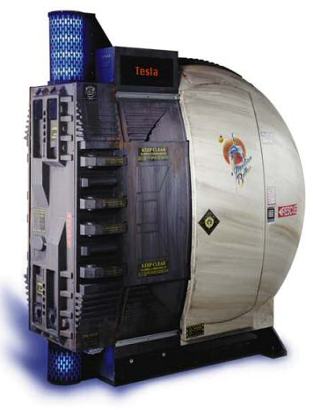
The Experience Machine

Slide 61
The Experience Machine
Since a life lived inside the Experience Machine is far more pleasurable than one lived outside it, a hedonist must say that a life lived inside the Experience Machine is better than a life lived outside it.

Slide 62
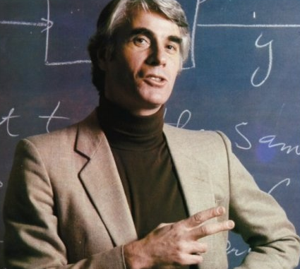
The Experience Machine
Robert Nozick, Anti-hedonist

Slide 63
The Experience Machine
“But,” says the anti-hedonist, “this is surely wrong. Haydn’s real life, for instance, had far greater value than a life confined to the Experience Machine!”
Robert Nozick, Anti-hedonist

Slide 64
The Experience Machine

Slide 65
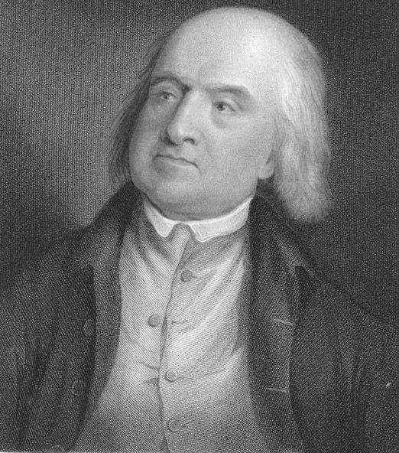
The Experience Machine
Jeremy Bentham, Hedonist

Slide 66
The Experience Machine
“I disagree,” replies the hedonist. “If this ‘Experience Machine’ works as you describe, then I say a life lived in it would be better than one lived outside of it.”
Jeremy Bentham, Hedonist

Slide 67
The Experience Machine
Well Bentham, you wouldn’t choose to enter the Experience Machine, would you?
Robert Nozick, Anti-hedonist

Slide 68
The Experience Machine
No, I wouldn’t. But you must remember that I am a non-egoistic hedonist. I have to consider the pleasure and pain of other people too.
Jeremy Bentham, Hedonist

Slide 69
The Experience Machine
Well, let’s suppose that the scientists have made a whole lot of Experience Machines. Now they give you the option of putting yourself and everyone else into Experience Machines. Would you do it?
Robert Nozick, Anti-hedonist

Slide 70
The Experience Machine
No, but only for the best of hedonic reasons: if we were all to enter Experience Machines, we would never have any more children, and would therefore sacrifice countless future pleasures, by putting an end to the human race.
Jeremy Bentham, Hedonist

Slide 71
The Experience Machine
Then suppose that the Experience Machines also take DNA samples to create more people, all within the confines of the Experience Machines. Humankind lives on inside the Experience Machines, enjoying pleasure galore.
Robert Nozick, Anti-hedonist

Slide 72
The Experience Machine
If I could make that happen, I would.
Jeremy Bentham, Hedonist

Slide 73
The Experience Machine
Are you serious?
Robert Nozick, Anti-hedonist

Slide 74
The Experience Machine
Do I look like I’m joking?
By entering the Experience Machines on these terms, we would have everything to gain, and nothing to lose.
Jeremy Bentham, Hedonist

Slide 75
The Experience Machine
Do I look like I’m joking?
By entering the Experience Machines on these terms, we would have everything to gain, and nothing to lose.
Jeremy Bentham, Hedonist

Slide 76
The Experience Machine
We would lose something. A life in the Experience Machine is not real: it is an illusion, a fake, a deception. In the Experience Machine you have no real friends, make no real discoveries, and make no important achievements.
Robert Nozick

Slide 77
The Experience Machine
Be that as it may, a person living in the Experience Machine has all the pleasure of a life full of friends, disc-overies, and achievements, which is all that matters.
After all, if we never got any pleasure out of friendship, discovery, or achievement, we wouldn’t care about those things.
Jeremy Bentham, Hedonist

Slide 78
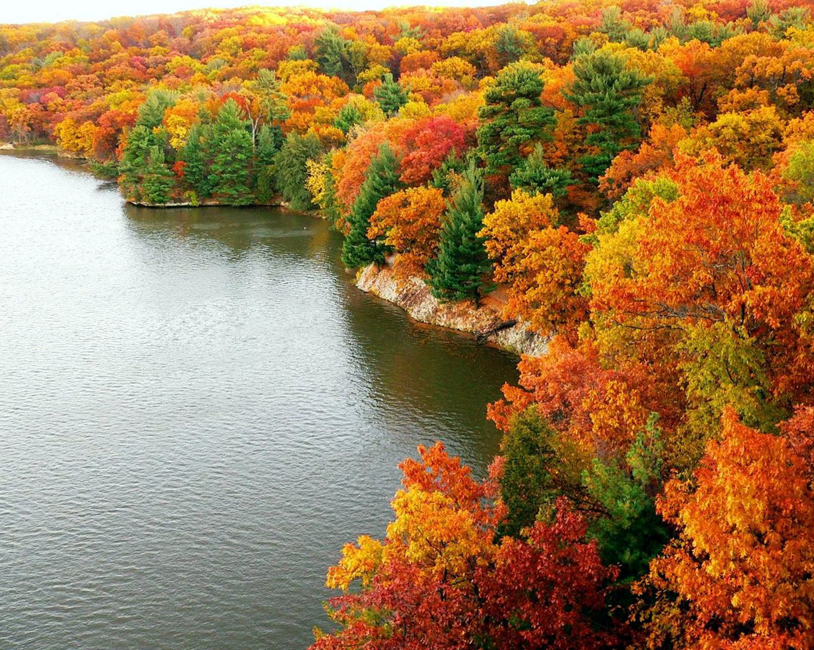
Argument from Beauty
Argument from Beauty

Slide 79
Consider two worlds.
Neither world contains any sentient beings: no people, no animals, no spirits, no deities, no artificial intelligences.

Slide 80
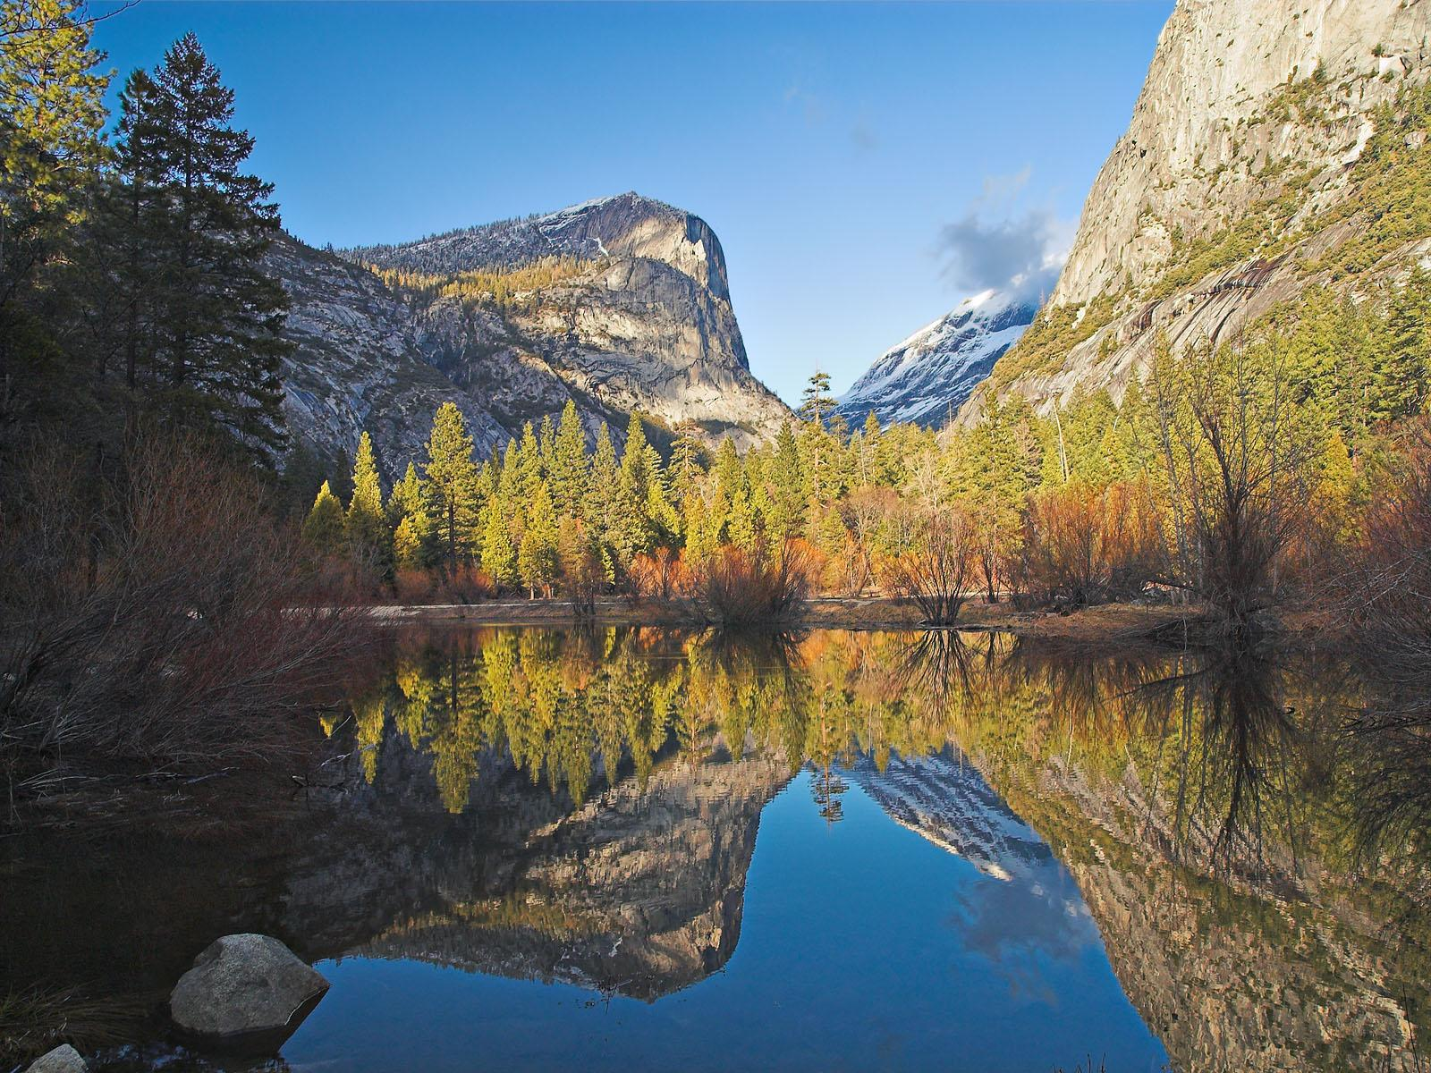
Mindless Worlds
One of the worlds is full of high mountains, clear lakes, deep forests, grassy plains, wide oceans, flowing rivers, towering cloud formations, etc. Call this “Beautiful World.”

Slide 81
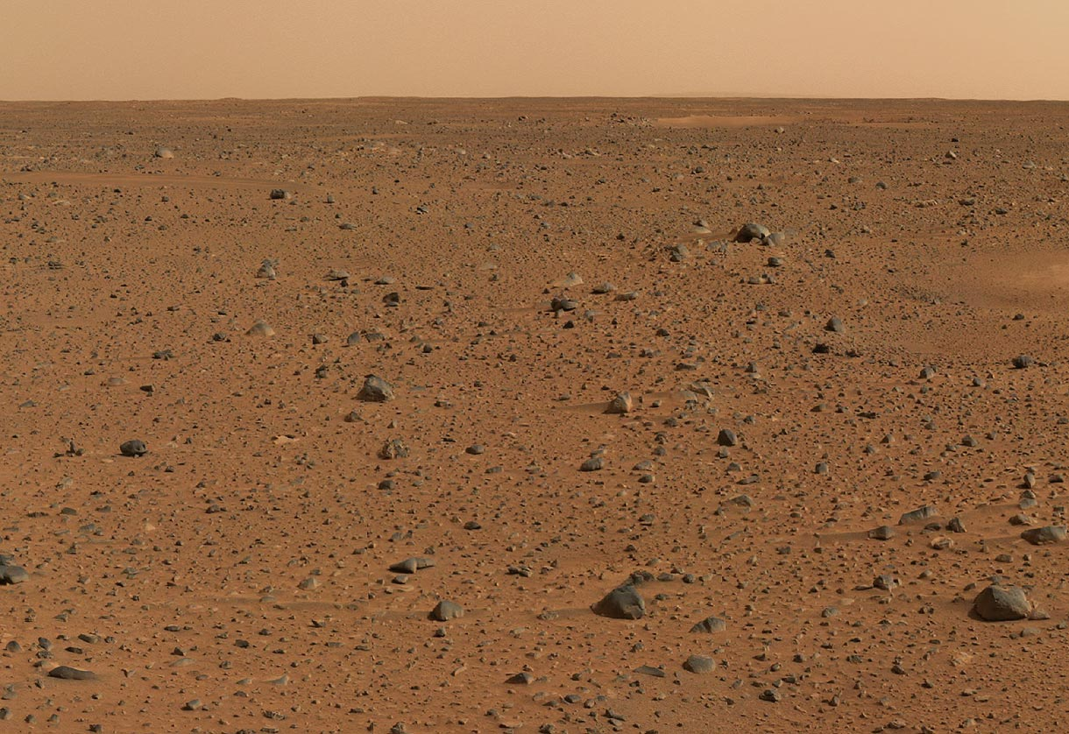
The other world contains nothing but dust and rubble under a dull sky. Call this “Ugly World.”

Slide 82
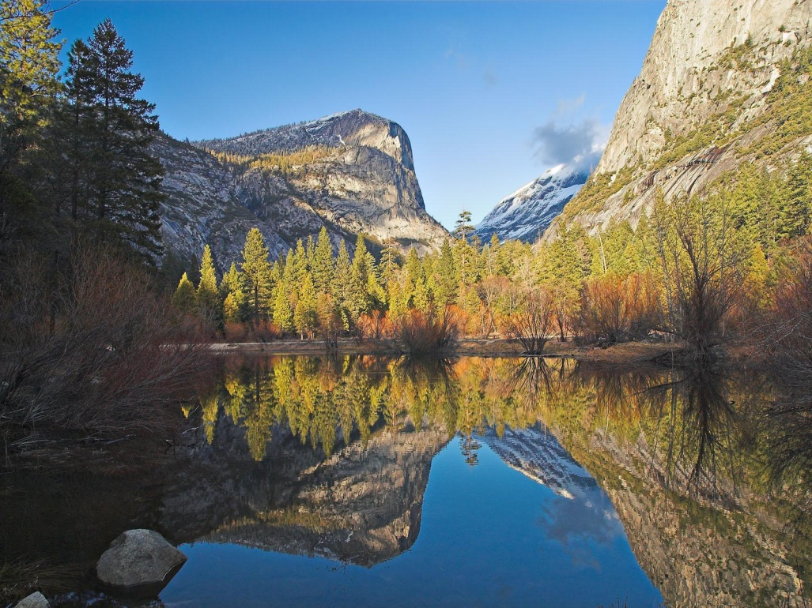
Which world is better?
If hedonism is the correct theory of value, the answer is...

Slide 83
Which world is better?
If hedonism is the correct theory of absolute value, the answer is...

Slide 84
Neither!

Slide 85
What should a hedonist say about this?
He can point out that a landscape that gives us pleasure might be considered ugly by Martians, who might derive great pleasure from viewing the (to us) barren Martian landscape.

Slide 87
So there is no absolute sense in which Beautiful World is better than Ugly World.

Slide 88
Summing up

Slide 89
Moral philosophy is the study of value (good and bad) and norms (right and wrong).
(Non-hedonic) hedonism is a theory of value that says that pleasure is the only thing that is good for its own sake, and pain is the only thing that is bad in and of itself.
Hedonism is an appealing theory, inasmuch as our ultimate rationale for doing the things we do is usually, if not always, to create pleasure or diminish pain (in ourselves or others).
Of the four arguments against hedonism that we considered, none of them succeeded in proving hedonism false.

Slide 90
Moral philosophy is the study of value (good and bad) and norms (right and wrong).
(Non-hedonic) hedonism is a theory of value that says that pleasure is the only thing that is good for its own sake, and pain is the only thing that is bad in and of itself.
Hedonism is an appealing theory, inasmuch as our ultimate rationale for doing the things we do is usually, if not always, to create pleasure or diminish pain (in ourselves or others).
Of the four arguments against hedonism that we considered, none of them succeeded in proving hedonism false.

Slide 91
Moral philosophy is the study of value (good and bad) and norms (right and wrong).
(Non-hedonic) hedonism is a theory of value that says that pleasure is the only thing that is good for its own sake, and pain is the only thing that is bad in and of itself.
Hedonism is an appealing theory, inasmuch as our ultimate rationale for doing the things we do is usually, if not always, to create pleasure or diminish pain (in ourselves or others).
Of the four arguments against hedonism that we considered, none of them succeeded in proving hedonism false.

Slide 92
Moral philosophy is the study of value (good and bad) and norms (right and wrong).
(Non-egoistic) hedonism is a theory of value that says that pleasure is the only thing that is good for its own sake, and pain is the only thing that is bad in and of itself.
Hedonism is an appealing theory, inasmuch as our ultimate rationale for doing the things we do is usually, if not always, to create pleasure or diminish pain (in ourselves or others).
Of the four arguments against hedonism that we considered, none of them succeeded in proving hedonism false.

Slide 93
End of lecture.

Slide 94
Weekly Assignment #2
In the reading for next week, Peter Singer entertains the principle that “if it is in our power to prevent something very bad from happening, without thereby sacrificing anything morally significant, we ought, morally, to do it.” Singer then asserts that if we were to live by this principle, “our lives, our society, and our world would be fundamentally changed.” Do you think that Singer’s assertion is true? Why or why not?
Limit: 200 words max.
Upload by 8:00pm, Thursday 4 September 2014

